Slide 1

PERSONAL PORTFOLIO

Slide 2
STUDENT PROFILE
NAME
REG NO/NMID
DEPARTMENT
COLLEGE
E.VISHAL
212403887/ED0F6F50A1B952B8B924EB46FCB7B6FB
COMPUTER APPLICATION
TAGORE COLLEGE OF ARTS AND SCIENCE CHROMEPET-44

Slide 3
PROJECT TITLE
PERSONAL PORTFOLIO

Slide 4
AGENDA
Problem Statement
Project Overview
End User
Tools and Technologies
Portfolio Design And Layout
Features and Functionality
Result and Screenshot
Conclusion
GitHub Link

Slide 5

PROBLEM STATEMENT
There is a need for a personal digital portfolio where a beginner UX & UI designer and front-end developer can showcase skills, experience, and achievements in a visually appealing and accessible manner.

Slide 6
PROJECT OVERVIEW
This project is a personal portfolio website for Vishal, focusing on presenting core skills, specializations, completed bootcamps, and a mechanism for visitors to get in touch. It aims to provide clarity for potential collaborators and employers.

Slide 7
WHO ARE THE END USER?
Recruiters searching for beginner front-end developers and UI/UX designers.
Collaborative professionals within the design and development ecosystem.
Anyone interested in viewing the designer’s work and journey.

Slide 8
TOOLS AND TECHNOLOGIES
VS Code (for editing and managing code).
HTML, CSS, and JavaScript (for building the interface and interactions).
Figma (tool for UI/UX and asset design).
Optionally, React.js or similar JS libraries can be used for modular components and dynamic content (not shown explicitly but can be derived from best practices).

Slide 9
PORTFOLIO DESIGN AND LAYOUT
Header featuring the portfolio owner’s name and navigation links (About, Portfolio, Contact).
Hero Section introduces Vishal with a catchy greeting, skills summary, and a call-to-action button.
About Me Section showcasing the developer’s background and growth ambitions.
Skills Journey uses progress circles to visually represent proficiency in UI/UX, Figma, and Java.
Specializations Section lists successfully completed bootcamps with a modern card layout.
Contact Form allows visitors to easily connect using name, email, and message inputs.
Clean and minimal dark-themed aesthetic, with accent blue highlights.

Slide 10
FEATURES AND FUNCTIONALITY
Navigation bar for quick access to core sections.
Responsive layout for optimal display across devices.
Interactive skill indicators (percent-based circles).
Showcase of completed bootcamps (JavaScript, Figma).
Contact form with basic validation for sending messages.
Engaging call-to-action button to view work.

Slide 11
RESULT AND SCREENSHOT
The portfolio achieves a professional online presence for Vishal, with:
Immediate identification and contact options for recruiters and collaborators.
Visual snapshot of skills and learning progress.
Certifiable credentials are prominently displayed.
Screenshots of each section were provided, demonstrating a consistent, attractive interface.

Slide 12
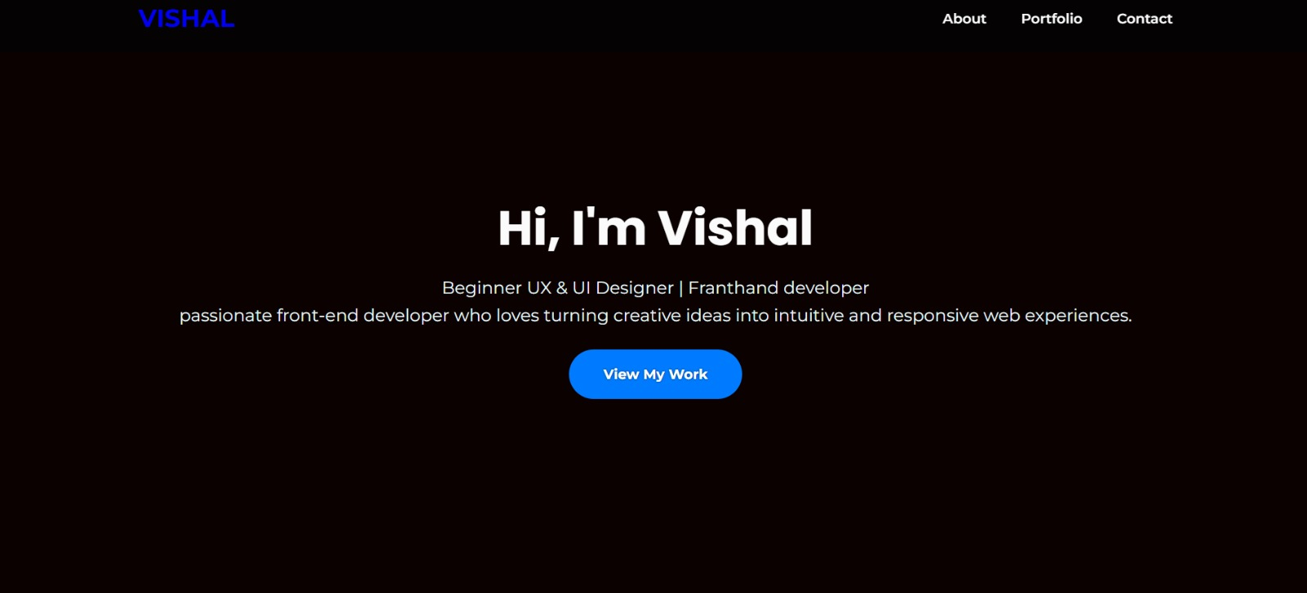

Slide 13
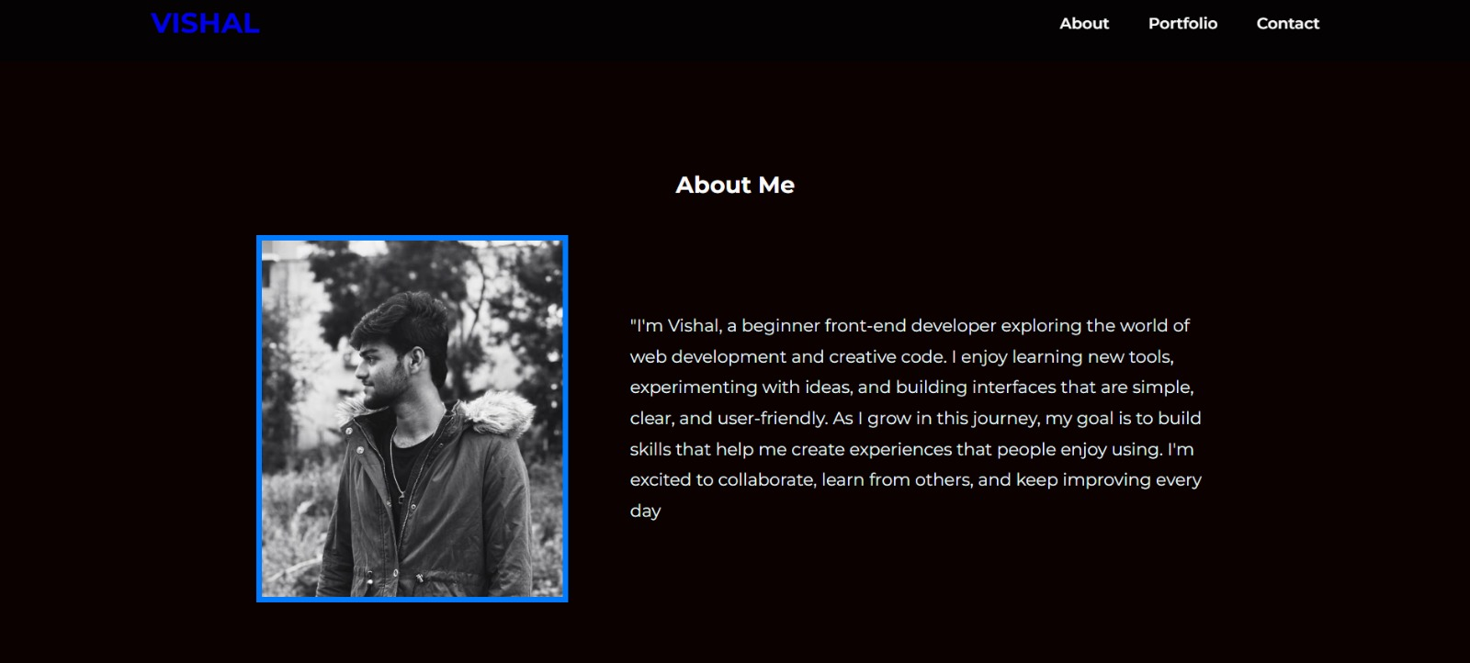

Slide 14
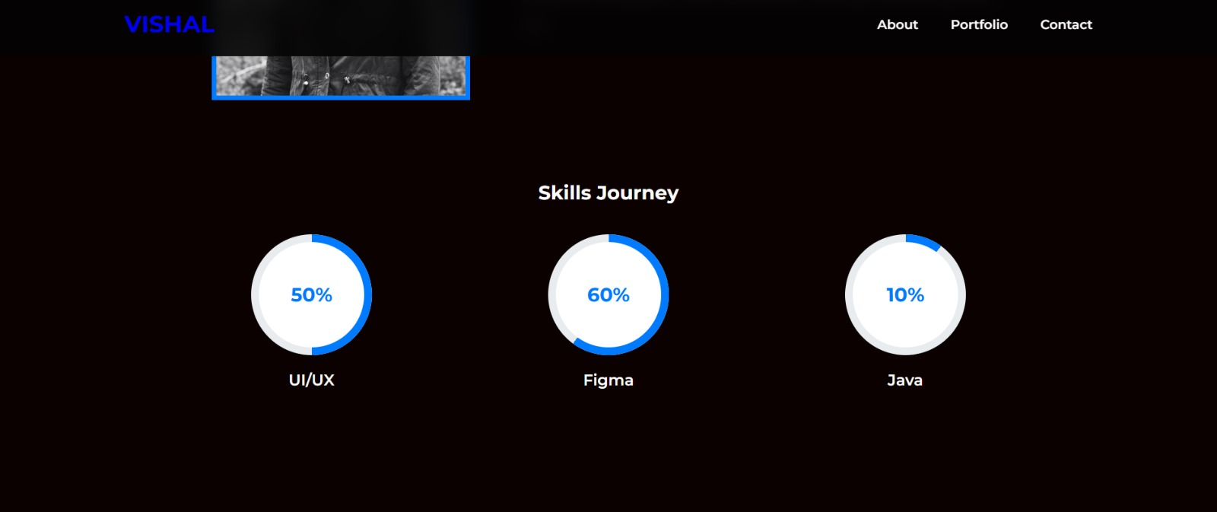

Slide 15
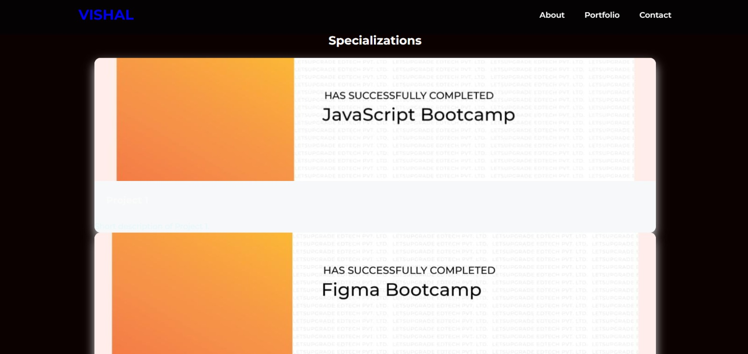

Slide 16
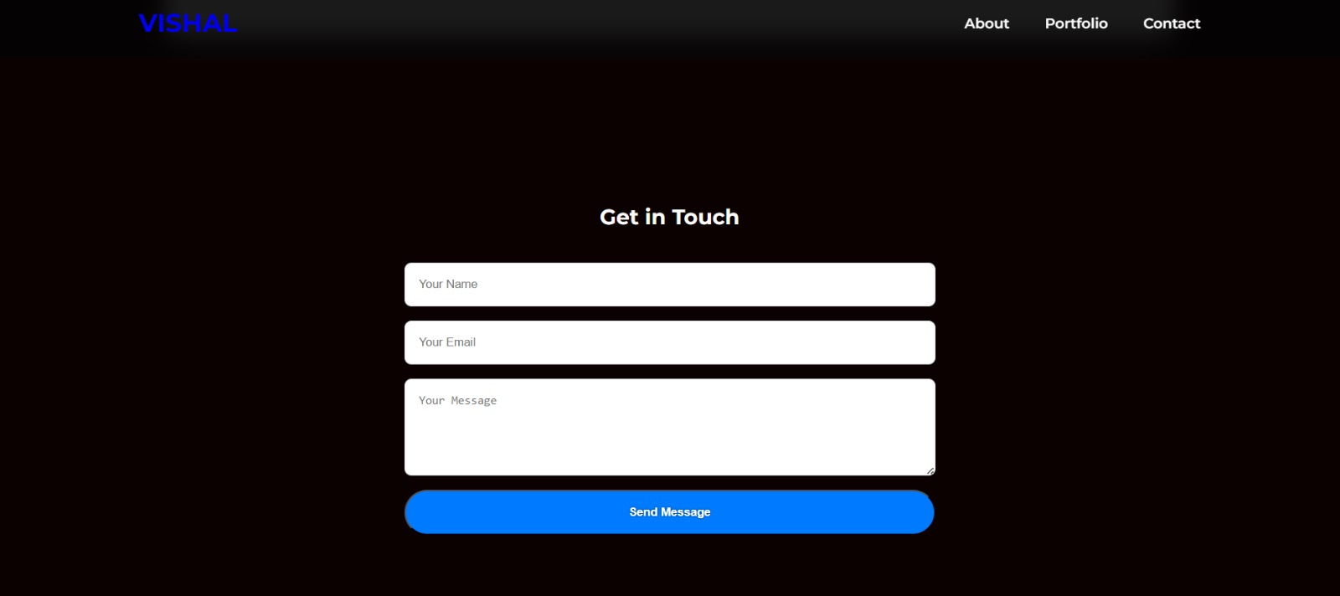

Slide 17
CONCLUSION
Building a personal portfolio in VS Code using widely accepted web technologies offers beginner developers like Vishal a foundational yet impactful way to showcase abilities, achievements, and facilitate professional networking. The design’s simplicity, skill visualization, and structured sections support both self-promotion and further personal development.

Slide 18
GITHUB LINK
https://vishal-29-07.github.io/Portfolio/

